Slide 1
Neurodiversity
Understanding and awareness of neurodiversity
Autism

Slide 2
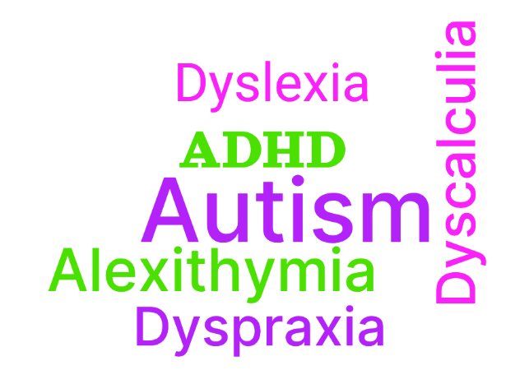
What is it?
Having a neurodiverse brain means you have sensory processing differences compared to the majority of the population
Notes:
Having a neurodiverse brain means you have sensory processing differences compared to the majority of the population
ADHD
Autism
Alexithymia
Dyslexia
Dyscalculia
Dyspraxia
DCD

Slide 3
Why is it important to understand?
Typical work environments (and the world in general) may be hostile to people with Autism & the neurodiverse population in general, year ending June 2021 only 29% of autistic people were in employment
Autistic adults are 9 times more likely to die from suicide, and Autistic children are 28 times more likely to think about or attempt suicide.

Slide 4
Damaging Stereotypes
Autism presents itself differently in women, compared to the stereotype of it only affecting white boys who like trains, or intelligent but rude men
Women may commonly be diagnosed with Borderline Personality Disorder
People of colour and those from other minority groups may also never get diagnosed
If you’ve met one autistic person, you’ve only met one autistic person
Notes:
Cite examples, sheldon cooper rainmap

Slide 5
General Statistics
“Brugha's 2009 survey of adults living in households throughout England found that 1.8% of men and boys surveyed had a diagnosis of autism, compared to 0.2% of women and girls”
“As recently as 2010, white kids were deemed 30% more likely to be diagnosed with autism than Black children and 50% more likely than Hispanic children”

Slide 6
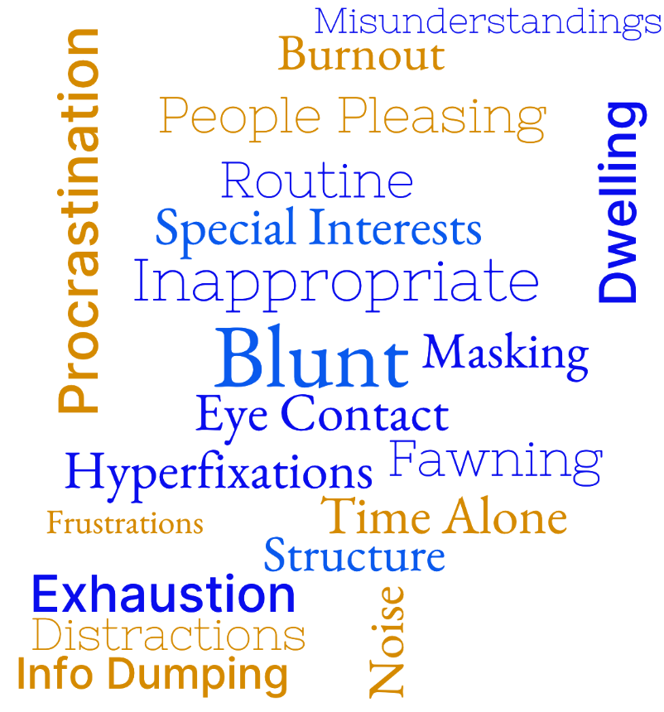
What is it Like?
Notes:
Shy and sensitive labels, forgotten to pee, unable to multi-task
Blunt
Inappropriate
Eye Contact
Special Interests
Hyperfixations
Time Alone
Procrastination
Dwelling
Routine
Structure
Masking
Fawning
People Pleasing
Noise
Exhaustion
Burnout
Noise
Distractions
Info Dumping
Misunderstandings
https://wordcloud.app/edit
Being blunt
Saying inappropriate things
Not making eye contact
Hyperfixations and special interests
Time alone
Difficulties to organise and starting tasks
Dwelling on past awkward events from long ago
Unable to read fireirieifrfidgidgoddfgdfgdgd tired
Needing routine and structure
MASKING
Fawning and people pleasing
Always exhausted
Not being able to hear things in noisy environments
Inability to pick out single noises, you can hear everything at once

Slide 7
Why can the work environment be so hostile?
Sensory issues
Communication differences
Differences in thinking
Lack of structure and routines
Masking to fit in

Slide 8
Sensory Issues
An autistic person may be very sensitive to;
Noise
Smells
Lighting Conditions
Busy Environments
With a need to have places in the office to retreat to when these sensory experiences get too much.
Often experiencing these things can either be painful, or joyful.
An Autistic person may be unable to filter out unwanted sensory input, it’s experienced all at once
Notes:
Highlight the consequences of a bad environment — “this then leads to..” i.e. exhaustion burnout

Slide 9
Communication Differences
Often the onus is put on the person with Autism to reach more than halfway when experiencing communication differences with another person
Tasks need to be communicated concisely
Communication preferences may not be verbal
Extra time may be needed to process information
Having the camera on and making eye contact may be uncomfortable
Try to avoid interruption people in mid-sentence

Slide 10
Communication Bad Example, The
Specify deadline dates directly
What you need and when
Bullet pointed list
Be literal, don’t imply
Try to avoid micromanaging
Be open to criticism that you may have communicated poorly
Avoid walls of text
Avoid meaningless small talk when it’s obvious you want something
Be open to different modes of preferred communications
Notes:
If communication bad, may dwell on awkward conversation for a long time. May blame yourself, may not understand it for a long time. Cite example about text messages, delayed responses, takes time to responses, doesn’t mean they don’t care.

Slide 11
Differences In Thinking
An Autistic person may think better in terms of images, or other abstractions, such as numbers
May struggle with simple things, such as tying shoe laces, or reading analogue clock faces (comorbidity traits)
May find relative complex tasks easy and easy tasks difficult
Notes:
Be open to different ways of working, and appreciate that somebody may be able to perform a task a lot better than you would assume in certain circumstances.

Slide 12
Lack Of Structure And Routine
Need for space for regular breaks, lunchtime should be a sacred space
Reduce the need for unexpected events
Need for flexible work patterns
A unexpected break in routine may cause distress
Empowered to say no to meetings
Structure need not be imposed, but created collaboratively
Notes:
It highlights the paradox with autism, needing structure, but also flexibility
NEED SEPARATE SLIDE TO HIGHLIGHT CONTRADICTION
Meetings agendas need to be clearly defined
Not too many in a day, without break – down to the individual ..?? empowering people again to say no..>?
Can be quite difficult to question meeting culture, to step out and question poor working practises when they’ve been done for a long time

Slide 13
Masking To Fit In
An autistic person may be masking to hide their behaviours, this is a survival strategy a person may develop to blend in with others to avoid consequences such as bullying, a lot of autistic people have a lifetime of trauma as a result
Hidden autistic behaviours may include the need to stim, such as hand flapping, rocking gentle or needing to pace
Masking may also mean engaging in activities that are difficult to take part in, formulating sentences may require extra effort
The consequences of masking all the time can be exhaustion and result in burnout
Notes:
People may also take advantage of you because you take longer to process and work out danger (trusting)
Some people asre sensory seeking, rather than avoidance
Burnout – acting and pretending all the time 24/7 can be exhausting
Don’t be a dick!!

Slide 14
Hidden Consequences
You may not see the visible consequences of a person living in a world not built for them, such as;
Meltdowns
Non-Verbal
Exhaustion & Burnout

Slide 15
Ways Of Working
Be open to individual ways of working, and be open to change, your way of working may be good for you, but damaging for another
Just because a certain way of working has been common practise for many years, doesn’t mean it’s an effective or a good way of working (be an agent for positive change, rather than a spokesperson for tradition)

Slide 16
A neurodiverse friendly workplace benefits us all!
Notes:
Not asking for special treating in accommodations, just a level playing field – but also this, it benefits!

Slide 17
Strength Based Mindsets
Hyperfocusing
Doing repetitive tasks quickly with high quality
Learning really quickly
Identifying patterns that nobody else can see quickly
Conventional thinking can sometimes slow down progress considerably
Difficult things to you, may be easy to a person with autism, and vice versa

Slide 18
What Can I Do To Help?
Challenge your own ways of thinking, not everybody thinks the same
When there is a misunderstanding or conflict, don’t assume the other person is the primary cause of the problem
Whilst feedback is useful, be considerate with feedback, open a dialogue, you may be commenting on a neurological condition that is impossible to change
Give space to people to allow time to process
When creating meetings ensure a clear agenda is defined with outcomes clearly stated in the description, allow others to make the choice about whether to attend
Don’t book important meetings during lunchtime
Challenge traditional working conventions
Don’t be a Dick
Notes:
Autistic person may be crap at job interviews
Don’t force eye contact
Not about changing people, but letting them know ways to help
ALL OF THESE CAN HELP, TRY TO DO AT LEAST ONE

Slide 19
Questions!

Slide 20
Follow up links;
https://embrace-autism.com/autism-tests/
https://embrace-autism.com/asrs-5/
https://monotropism.org/
https://adhdaware.org.uk/what-is-adhd/neurodiversity-and-other-conditions/
https://hdsunflower.com/us/insights/post/for-people-with-non-visible-disabilities
https://www.ons.gov.uk/peoplepopulationandcommunity/healthandsocialcare/disability/articles/outcomesfordisabledpeopleintheuk/2021
https://www.autistica.org.uk/what-is-autism/signs-and-symptoms/suicide-and-autism
https://www.autism.org.uk/advice-and-guidance/what-is-autism/autistic-women-and-girls
https://apnews.com/article/how-common-is-autism-e38179682e2759b0aff9c017bf7ebf61#:~:text=That's%20up%20from%201%20in,about%202%25%20of%20white%20kids.

Slide 21
Recommended Reading;
https://www.amazon.co.uk/Unmasking-Autism-Incredible-Hidden-Neurodiversity/dp/1800960549
https://www.amazon.co.uk/Adult-Autism-Assessment-Handbook-Neurodiversity/dp/1839971665/ref=sr_1_5?crid=2094IACOVUR64&keywords=autism+handbook&qid=1699372286&s=books&sprefix=autism+handbook%2Cstripbooks%2C65&sr=1-5

Slide 24
Strength based, rather than deficit based
Autism Spectrum Disorder
Rather than

Slide 25
NOT BEING YOURSELF (MASKING)
Survival strategy

Slide 26
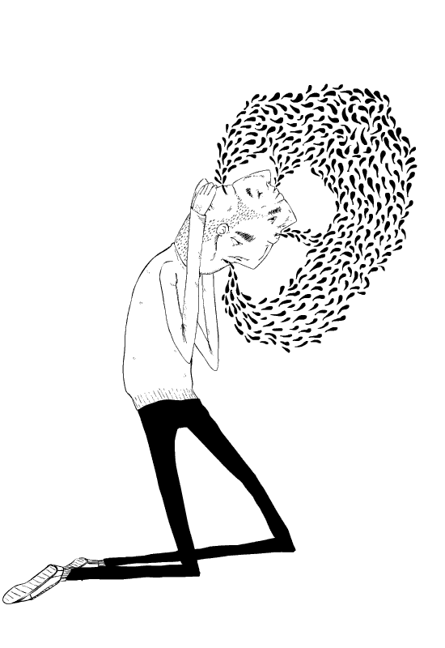
A life of contradictions
You may be ok in one scenario, but not ok in a similar scenario
You may seek out sensory experiences, but also get overwhelmed by them
You need structure but it becomes mundane
So many more…

Slide 27
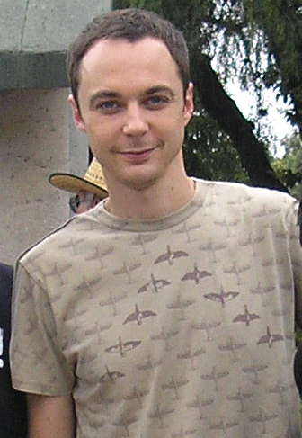
Negative Stereotypes
“Not all neurodiverse people are super smart and rude” - Me, just now.
“Not all neurodiverse traits are bad” - Me, just after now.
“Sheldon Cooper can kiss my arse” - Also Me, then, which was also now.

Slide 28
Common Traits -same as slide above?
Sensory differences
Ability to focus intently on a single task (hyper focusing)
Ability to also get easily distracted
Need for routine and structure
Difficulties with task switching
Think differently, may think in terms of images rather than words
Taking things literally and thinking in black and white terms
Communicate differently

Slide 29
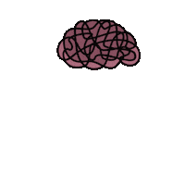
We Are Not All The Same
However, there is a not a single trait that defines neurodiversity, if you’ve met one autistic person, you’ve met one autistic person.
Not all of us like trains.
Conditions aren’t limited to just affecting children.

Slide 30
Somebody May Need
More clearly defined tasks, and with a more literal statement of things you may think are obvious (PROVIDE EXAMPLE)
Consideration for preferred communication methods, such as slack messages, rather than video calls (eye contact?)
Routine and structure (not enforced upon them, but defined with a collaborative approach)
More time to process new information, time to pick up new tasks, task switching should be avoided as much as possible
For personal space not to be invaded

Slide 31
Consequences Of Unmet Needs
Meltdowns/shutdowns (all of which may occur in private)
Unable to speak
Too exhausted at end of the day to do anything else

Slide 32
Empowering Control Over Meetings
Flexibility with meetings, with options to not attend if the meeting appears to be irrelevant or the meeting agenda hasn't been clearly communicated
The option to keep the camera off during meetings (eye contact may be uncomfortable)
Breaks before and after meetings, for preparation time and rest time
Reiterate the need for sacred times of day for no meetings (such as lunchtime)

Slide 33
Shared Responsibilities
“The responsibilities of creating a good neurodiverse environment are a shared responsibility, for neurotypicals and the neurodiverse” - Me, again, just now.
“A neurodiverse workplace is good for everyone” - Me, once more, about a week ago.

Slide 34
Work Environment
A typical office may be a source of anxiety, providing sensory overload, relating to excessive background noises, smells and poor or overly bright lighting, such as fluorescent lights.
Somebody may be unable to “tune out” these sensory experiences and can be overwhelmed.
Notes:
Offer small adjustments to an employee's workspace to accommodate any sensory needs, such as
Sound sensitivity: Offer a quiet break space, communicate expected loud noises (like fire drills), offer noise-cancelling headphones.
Tactile: Allow modifications to the usual work uniform.
Movements: Allow the use of fidget toys, allow extra movement breaks, offer flexible seating.
Use a clear communication style:
Avoid sarcasm, euphemisms, and implied messages.
Provide concise verbal and written instructions for tasks, and break tasks down into small steps.
Inform people about workplace/social etiquette, and don't assume someone is deliberately breaking the rules or being rude.
Try to give advance notice if plans are changing, and provide a reason for the change.
Don't make assumptions — ask a person's individual preferences, needs, and goals.
Be kind, be patient.
https://www.health.harvard.edu/blog/what-is-neurodiversity-202111232645

Slide 35
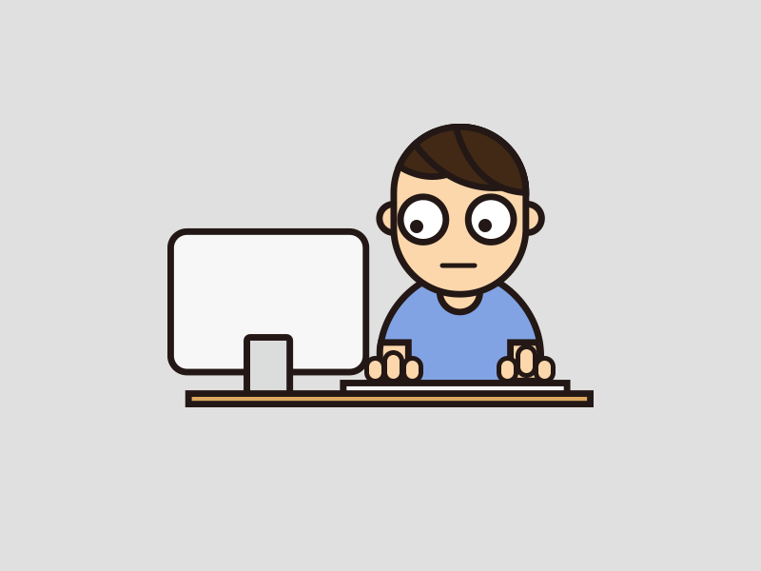
Ways Of Working
Be open to individual ways of working, and be open to change, your way of working may be good for you, but damaging for another
Just because a certain way of working has been common practise for many years, doesn’t mean it’s an effective or a good way of working (be an agent for positive change, rather than a spokesperson for tradition)

Slide 36
Being An Effective Communicator
Try to be specific, descriptive and concise in how you communicate, you may be unaware that you are communicating in an ambiguous style
Ask others about their preferred method of communication, it may be different to yours, how do you like to receive information? Verbally? Text? Diagrams? Audio/Video Call?
Consider that your preferred method of communication isn’t the most effective way to communicate
Notes:
Consideration if you are communicating ambiguously with another person
Consideration if your chosen method of communication is preferred by the other person

Slide 37
Structure
Create structure and routines within client environments as quickly as possible, reduce the unknowns
Encourage people to be in control of their day-to-day working structure and routines
With structure, you enable the creation of a healthy culture

Slide 38
Strengths
Appeal to people’s strengths, somebody on the spectrum may be very good at things you may think are difficult, and struggle with things you may find easy

Slide 39
Questions?

Slide 40
OVER AND OUT
Add example of clearly explained tasks
Duplicate information in some slides
Add colour
Talk a bit about masking and fawning
Self-diagnosis is OK

Slide 42
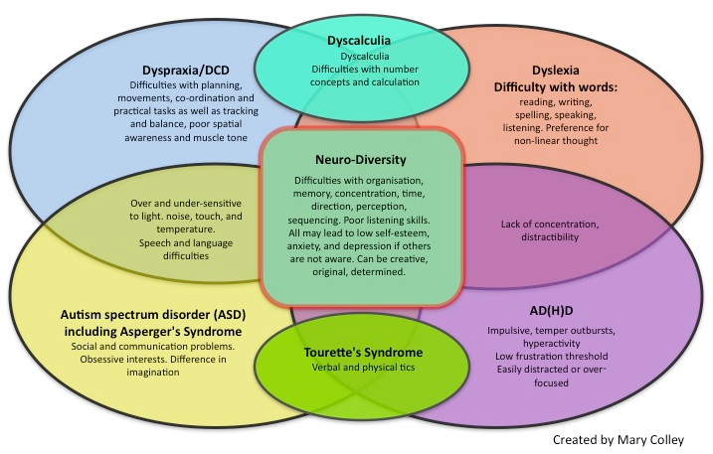
What is neurodiversity?
Neurodiversity describes the idea that people experience and interact with the world around them in many different ways; there is no one "right" way of thinking, learning, and behaving, and differences are not viewed as deficits

Slide 43
Our Clients
“A neurodiverse mindset first not only benefits us, but also helps improve our clients” - Garfield the cat, probably
Helping them define structure and routine
Teach them to tackle unknowns quickly
Help them look after their employees
Create a healthier work environment
Teach them to gain the best of out of their employees diverse ways of thinking

Slide 44
Understanding Autism and ADHD
Building a neurodiverse workplace

Slide 45
Negative Stereotypes
“Not all neurodiverse people are super smart and rude” - Me, just now.
“Not all neurodiverse traits are bad” - Me, just after now.
“Sheldon Cooper can kiss my arse” - Also Me, then, which was also now.

Slide 46

A Life Of Contradictions
You may be ok in one scenario, but not ok in a similar scenario
You may seek out sensory experiences, but also get overwhelmed by them

